Slide 1
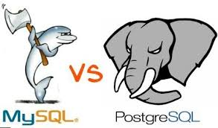
Presented by:
Steven, Yashwanth,
Ritu, Srinivas, Kiran

Slide 2
Outline
Introduction
MySQL Spin-Offs
MySQL- Features, adv., dis
PostgreSQL- Features, adv., dis
Similarities
Major Differences
Factors
Demo
References

Slide 3
Introduction
 | PostgreSQL | MySQL
Initial Release | July 1996 | May 1995
Stable Release | October 2016 | October 2016
Developer | PostgreSQL Global Development Group | MySQL AB (now owned by Oracle Corporation)
Written in | C | C / C++
Platforms | Windows, Linux, FreeBSD, OpenBSD, NetBSD, OS X, AIX, HP-UX, Solaris, UnixWare | Windows, Linux, FreeBSD, OpenBSD, NetBSD, OS X, AIX, HP-UX, Solaris, UnixWare, BSDi, eComStation, IRIX, Novell NetWare, QNX, Symbian, SunOS, SCO OpenServer, Sanos, Tru64

Slide 4
MySQL
Features
Adheres to SQL standard
Stored procedures
Automatic triggers
SubSELECTs
Unicode support
ACID compliance
Referential integrity
Replication
Transaction
Multiversion Concurrency Control
Foreign Key Constraints

Slide 5
MySQL
Data types
TINYINT
SMALLINT
MEDIUMINT
INT or INTEGER
BIGINT
FLOAT
DOUBLE, DOUBLE PRECISION, REAL
DECIMAL, NUMERIC
DATE
DATETIME
TIMESTAMP
TIME
YEAR
CHAR
VARCHAR
TINYBLOB, TINYTEXT
BLOB, TEXT
MEDIUMBLOB, MEDIUMTEXT
ENUM
SET

Slide 6
MySQL
Advantages
Easy to use
Third party tools, such as GUIs, available
Widely available
Lots of features
Secure
Fast
Cuts corners as far as some standards are concerned
Scalable
Powerful
Can handle a large amount of data

Slide 7
MySQL
Disadvantages
Limitations
Not built to handle everything
Missing some functions featured in other systems
Less reliable than other RDBMSs
Less stable than other RDBMSs
Stagnated development under current owner
Development of other systems is community-driven
Many features dependent on applications add-ons

Slide 8
MySQL Spin-offs
Forks of MySQL code were created out of concerns about the acquisition of MySQL by Oracle from Sun
Forks intended to remain free under the GNU GPL
Development of MySQL stagnated after buyout
Several widely-used forks
MariaDB
Developed by original MySQL founders
Percona Server
Drizzle
Why does Postgres not have many forks?
Still actively developed
Most forks used in private projects

Slide 9
PostgreSQL features 1.ANSI/ISO SQL standards. 2.Atomicity,consistency,isolation,durability(ACID). 3.Multiversion concurrency control(MVCC). 4.Highly programmable “stored procedures”. 5.Third party tools.(Pgadmin III, phppgadmin, Adminer, etc.….)

Slide 10
More about…. 1.More than 15 years of active development. 2.Proven architecture that has earned it a strong reputation for reliability, data integrity, and correctness. 3.Runs on all major operating systems. 4.Full support for foreign keys, views, joins, triggers. 5. It has native programming interfaces for C/C++, java, .NET, python, perl, ruby, etc.,

Slide 11
Sophisticated features… 1.Point-in-time recovery(maintains write ahead log(WAL). 2.Tablespaces(define locations in file system) administrator can control the disk layout. 3.Streaming Asynchronous replication. 4.Nested transactions(savepoints). 5.Sophisticated query planner/optimizer.

Slide 12
Supporting Data Types (a few…) 1.bigint:- signed eight-byte integer. 2. bigserial:- autoincrementing eight-byte integer. 3.date:- Calendar date (year,month,day). 4.money:- currency amount. 5.numeric[(p,s)]:- exact numeric of selectable precision. 6.point:- geometric point on plane. 7.tsquery:- text search query. 8.tsvector:- text search document. 9.xml:- xml data.

Slide 13
Advantages. 1.An open source sql standard compliant RDBMS. PostgreSQL is open-source and free, yet a very powerful relational database management system. 2. Strong community: PostgreSQL is supported by a devoted and experienced community which can be accessed through knowledge-bases and Q&A sites 24/7 for free. 3. Strong third-party support: Regardless of the extremely advanced features, PostgreSQL is adorned with many great and open-source third-party tools for designing, managing and using the management system. 4. Extensible: It is possible to extend PostgreSQL programmatically with stored procedures, like an advanced RDBMS should be. 5. Objective: PostgreSQL is not just a relational database management system but an objective one -with support for nesting, and more.

Slide 14
Disadvantages 1. Performance: For simple read-heavy operations, PostgreSQL can be an over-kill and might appear less performant than the counterparts, such as MySQL. 2. Popularity: Given the nature of this tool, it lacks behind in terms of popularity, despite the very large amount of deployments - which might affect how easy it might be possible to get support. 3. Hosting: Due to above mentioned factors, it is harder to come by hosts or service providers that offer managed PostgreSQL instances.

Slide 15
When To Use PostgreSQL? 1. Data integrity: When reliability and data integrity are an absolute necessity without excuses, PostgreSQL is the better choice. 2. Complex, custom procedures: If you require your database to perform custom procedures, PostgreSQL, being extensible, is the better choice. 3. Integration: In the future, if there is a chance of necessity arising for migrating the entire database system to a propriety (e.g. Oracle) solution, PostgreSQL will be the most compliant and easy to handle base for the switch. 4. Complex designs: Compared to other open-source and free RDBMS implementations, for complex database designs, PostgreSQL offers the most in terms of functionality and possibilities without giving up on other valuable assets.

Slide 16
When Not To Use PostgreSQL? 1. Speed: If all you require is fast read operations, PostgreSQL is not the tool to go for. 2. Simple set ups: Unless you require absolute data integrity, ACID compliance or complex designs, PostgreSQL can be an over-kill for simple set-ups. 3. Replication: Unless you are willing to spend the time, energy and resources, achieving replication with MySQL might be simpler for those who lack the database and system administration experience.

Slide 17
Similarities
Queries
GROUP BY .. ROLLUP [since 9.5].
Aggregates for strings.
Tuple comparison.
UPDATE with a join.
Regular expressions
Comparison based on RegEx.
Constraints
ON DELETE CASCADE.
ON UPDATE CASCADE

Slide 18
Indexing
Duplicate NULL values in unique index.
DML
Multi-row INSERTs.
MERGE support.
Data Types
Enums(*)
TIME
DATE
TIMESTAMP
DDL
Auto increment columns.
Partitioning[inheritance].

Slide 19
Temporary Tables
Session local temporary tables.
Programming
Stored procedures.
Row level triggers.
Before triggers.
Views
Updateable Views.
WITH CHECK OPTION.
JOINs and Operators
CROSS JOIN.
JOIN ... USING (...).
JOINs using tuple comparison.
IS DISTINCT FROM.

Slide 20
noSQL features
XML Support.
Xpath.
JSON.
Security
Grant on column level.

Slide 21
Major Differences
The differences between MySQL and PostgreSQL include the following key categories:
Governance
Supported platforms
Access Methods
Partitioning
Replication
Partitioning in MySQL is horizontal whereas in PostgreSQL it is achieved by inheritance.
Inheritance.
Partitioning via inheritance.

Slide 22
The various supported MySQL replication topologies include:
Single master to one slave
• Single master to multiple slaves
• Single master to one slave to one or more slaves
• Circular replication (A to B to C and back to A)
• Master to master

Slide 23
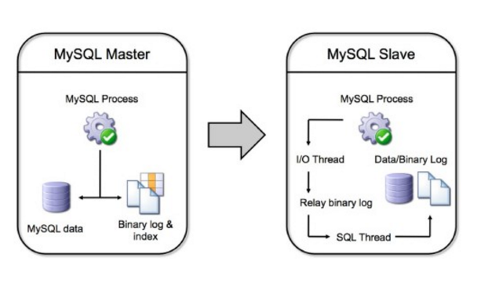
A graphical view of how MySQL replication functions can be represented as follows:

Slide 24
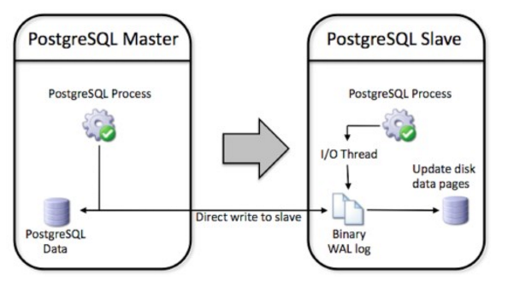
The supported PostgreSQL replication topologies include:
• Single master to one slave
• Single master to multiple slaves

Slide 25
MySQL users.
Wikipedia.
Flickr.
Google (excluding Search)
YouTube
Twitter
Facebook
PostgreSQL users.
Apple
Fujitsu
OmniTI
Red Hat
Sirius IT

Slide 26
General Factors
ACID Compliance
SQL Dialects
Locking
JSON Type
PSQL - API

Slide 27
ACID Compliance
Atomicity
Is an all-or-none proposition.
Example :- Bank Transaction.

Slide 28
ACID Compliance
Consistency
Guarantees that a transaction never leaves your database in a half–finished state.
Example :- Deleting customer record.

Slide 29
ACID Compliance
Isolation
Keeps transactions separated from each other until they are finished.
Example :- Deleting and updating a record at same time by different users.

Slide 30
ACID Compliance
Durability
Keep track of pending changes.
Ex- Unplugged database server in the middle of transaction.

Slide 31
Locking
Types of locking
Table level.
Row level.
Page level.
Deadlocks.

Slide 32
SQL Dialects
All agrees on fundamentals such as select, insert, update and delete.
Supports a richer dialects than MySQL.
Supports subqueries .
Ex- reduce salary of the highest paid employees by 75%.

Slide 33
JSON types
Newer version like 9.4, 9.5 and 9.6 supports JSON data type.
Two types
JSON
JSONB
JSON | JSONB
Stores exactly same | Decompose to binary format
Accepts white spaces | Does not
Order of keys | No order of keys
Accepts same key more than once | No duplication of object keys

Slide 34
JSON Datatype Example
Create Table Json_test(
id serial primary key,
data Jsonb
) ;
Insert into Json_test(data) values
(‘{ }’),
(‘ { “a” :1 } ’ ),
( ‘ { “a”: 2, ” b ” : [ “c” : ”d” ] } ’ );
Select * from Json_test where data = ‘ { “a”: 1 } ’;

Slide 35
PSQL-API
Offers RESTFUL API access and API administration tools.
A web interface is used for administration.
Developed by Q-B’s consult and

Slide 36
DEMO……

Slide 37
References
https://www.postgresql.org/
http://db-engines.com/en/system/MySQL%3BPostgreSQL
https://www.quora.com/What-is-the-difference-between-replication-partitioning-clustering-and-sharding
http://www.wikivs.com/wiki/MySQL_vs_PostgreSQL
https://www.digitalocean.com/community/tutorials/sqlite-vs-mysql-vs-postgresql-a-comparison-of-relational-database-management-systems
http://www.sql-workbench.net/dbms_comparison.html
https://www.zaiste.net/2014/07/table_inheritance_and_partitioning_with_postgresql/

